Slide 1


JSPM’s
Rajarshi Shahu College of Engineering, Tathawade, Pune
(An Autonomous Institute affiliated to Savitribai Phule Pune University)
Department of Computer Science and Business Systems
Academic Year: 2026-27
Project Title:
“VEHICLE SERVICE AND MAINTENANCE MANAGEMENT SYSTEM”
Students Name and PRN no: [Sarthak Jagtap] (RBT25CB039)
[Mehul Deogadkar] (RBT25CB027)
Date: [13-10-2026]
Course Name: Database Management System
Course Coordinator: Prof. Rutuja S. Bachhav

Slide 2
Index
Introduction
Problem Definition & Objectives
Literature Survey
Feasibility Study
System Design & Architecture
Database Design & ER Diagram
SQL Implementation & Results
Conclusion
References

Slide 3








Introduction / Background
Definition & Overview
Evolution / Background
Why It Matters
Definition
A database-driven system that manages vehicles, service bookings, mechanics, workshop bays and billing in one place.
Overview
It links customers, vehicles, services, mechanics, departments, bays and bills, so every job can be tracked from booking to billing.
Domain context
Automotive service centres, garages and fleet maintenance.
1
Paper era
Job cards, logbooks and service stickers
Safety & reliability
Timely servicing prevents breakdowns
Cost control
Fewer billing errors and less paperwork
2
Spreadsheet era
Excel sheets and stand-alone billing tools
Customer trust
Complete service history on demand
3
Database era
Central relational databases, now extended with cloud apps and telematics-based service reminders
Better planning
Mechanics and bays used efficiently
Technology: MySQL | SQL | MySQL Workbench

Slide 4

Problem Definition & Objectives
Problem Definition
Objectives
Service centres still depend on paper job cards and scattered registers. Records are slow to find, bookings and bays clash, and bills contain errors.
1
Centralise customer and vehicle records
2
Manage service bookings and service dates
Key problems
Scattered and duplicate records
Booking and bay clashes
No quick view of a vehicle's service history
No clear record of which mechanic did which job
Manual billing mistakes
3
Assign mechanics by specialization and department
4
Track workshop bay allocation and availability
5
Generate and store customer bills
6
Retrieve data quickly and accurately using SQL
Goal: Replace manual service-centre record keeping with one structured relational database.

Slide 5

Literature Survey
Existing Systems
Limitations
Proposed Approach
Manual job cards and registers
Spreadsheets (Excel sheets)
Stand-alone billing or basic workshop software
Commercial CMMS and dealer software: powerful, but often costly and complex for small workshops
Slow searching of records
Duplicate and inconsistent data
No complete service history for each vehicle
Booking, mechanic and bay clashes
Higher risk of billing errors
A relational MySQL database links Customer, Vehicle, Service, Mechanic, Department, Bay and Bill through primary and foreign keys.
Fast, accurate retrieval with SQL
Open-source and low cost
Easy to extend with new modules
Theoretical foundation: Relational model, E. F. Codd (1970) | Entity–Relationship model, P. P. Chen (1976)

Slide 6




Feasibility Study
Technical Feasibility
Financial / Business
Operational Feasibility
MySQL database with MySQL Workbench
Standard SQL: DDL, DML, joins and constraints
Primary and foreign keys keep data consistent
Runs on an ordinary PC, no special hardware
MySQL Community Edition is free and open source
Low development and maintenance cost
Saves staff time on searching and data entry
Fewer billing errors protect revenue
Simple 7-entity design that is easy to learn
Faster booking, mechanic assignment and billing
Staff can find any record with a simple query
Easy to extend with new modules later
Feasible
Feasible
Feasible
Conclusion: The project is technically, financially and operationally feasible.

Slide 7





System Design & Architecture
Users
Customer · Service Advisor · Workshop Admin
Core Modules
Customer & Vehicle
Customer details and registered vehicles
Vehicle Service & Maintenance Management System
SQL: booking, mechanic assignment, bay allocation, billing
Service Booking
Service requests with service dates
Mechanic & Department
Mechanic skills and department assignment
MySQL Database
Designed and managed with MySQL Workbench
Bay Management
Bay type and occupied status
Customer
Vehicle
Service
Mechanic
Department
Bay
Bill
Billing
Bills and amounts for each customer
+ Customer_Phone, Mechanic_Specialization (multivalued attributes)

Slide 8
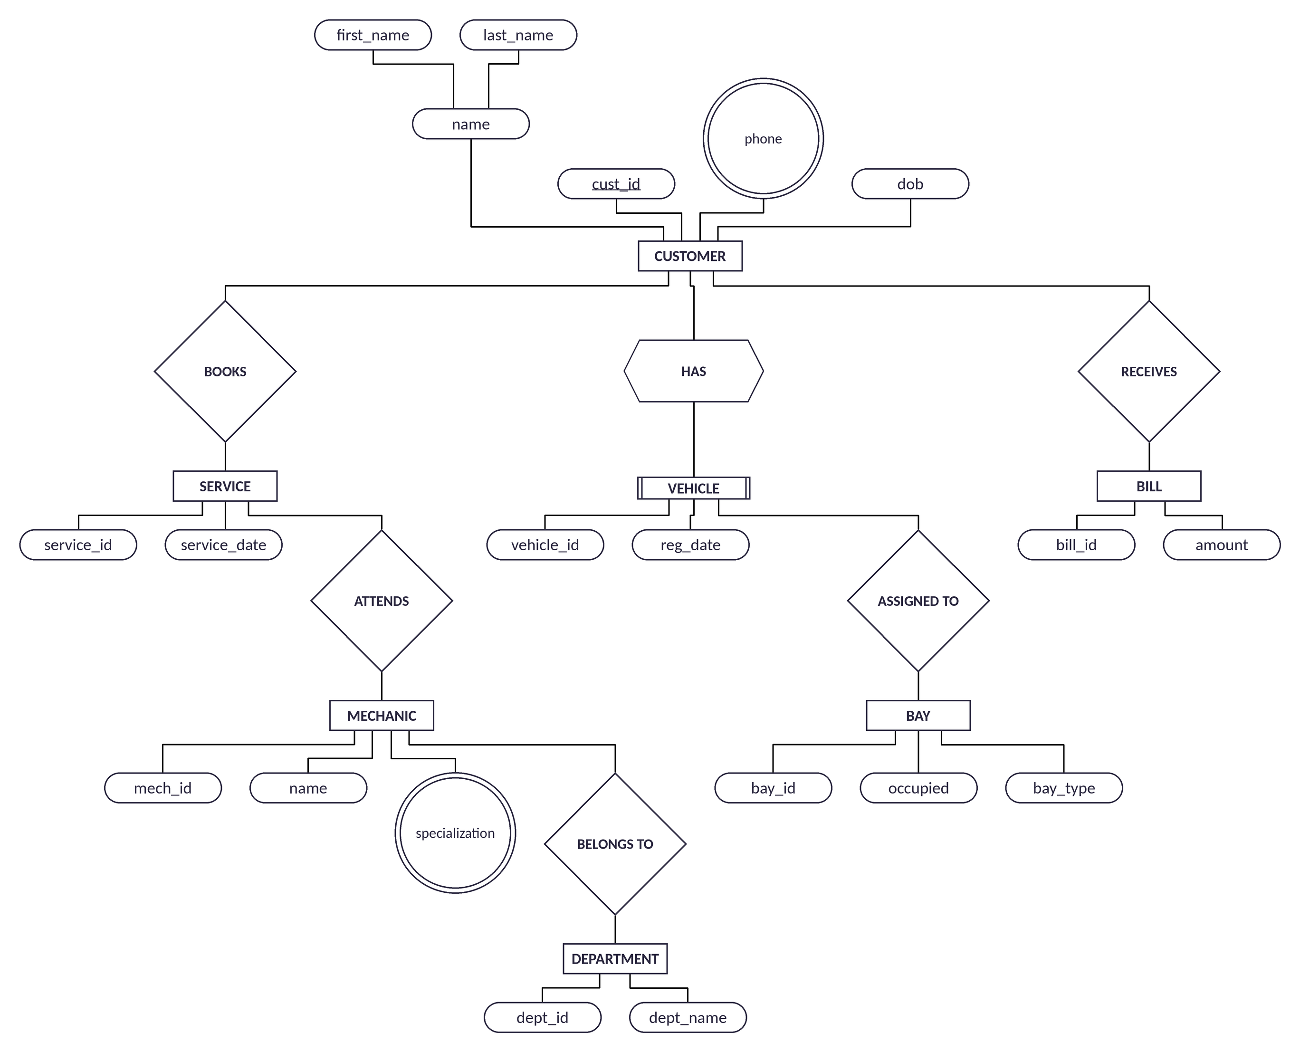
Database Design & ER Diagram
Table | Purpose
Customer | Customer details and phone numbers
Vehicle | Vehicles owned by customers
Service | Service bookings and dates
Mechanic | Mechanic details and specializations
Department | Workshop departments
Bay | Service bays: type and occupied status
Bill | Bills and amounts for customers
Multivalued attributes (phone, specialization) are kept in their own tables: Customer_Phone and Mechanic_Specialization.
Key Relationships
Customer → HAS → Vehicle → ASSIGNED TO → Bay
Customer → BOOKS → Service → ATTENDS → Mechanic
Mechanic → BELONGS TO → Department
Customer → RECEIVES → Bill

Slide 9
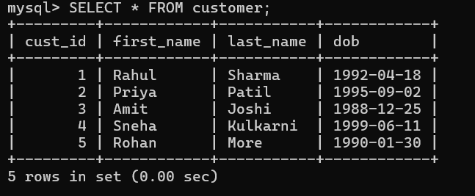
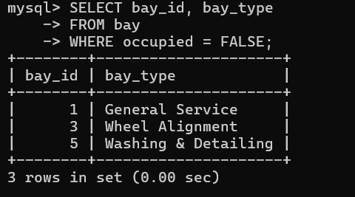
SQL Implementation & Results
SQL Operations
CREATE → Database and 9 tables with PK / FK constraints
INSERT → Sample customers, vehicles, services and bills
SELECT / WHERE → Retrieve and filter records
JOIN → Combine related tables
GROUP BY → Total billed amount per customer
UPDATE → Change a bay’s occupied status
Sample SQL
CREATE TABLE vehicle (
vehicle_id INT AUTO_INCREMENT PRIMARY KEY,
reg_date DATE NOT NULL,
cust_id INT NOT NULL,
bay_id INT NULL,
FOREIGN KEY (cust_id) REFERENCES customer(cust_id),
FOREIGN KEY (bay_id) REFERENCES bay(bay_id)
);
SELECT s.service_id, s.service_date, m.name
FROM service s
JOIN mechanic m ON s.mech_id = m.mech_id;

Slide 10
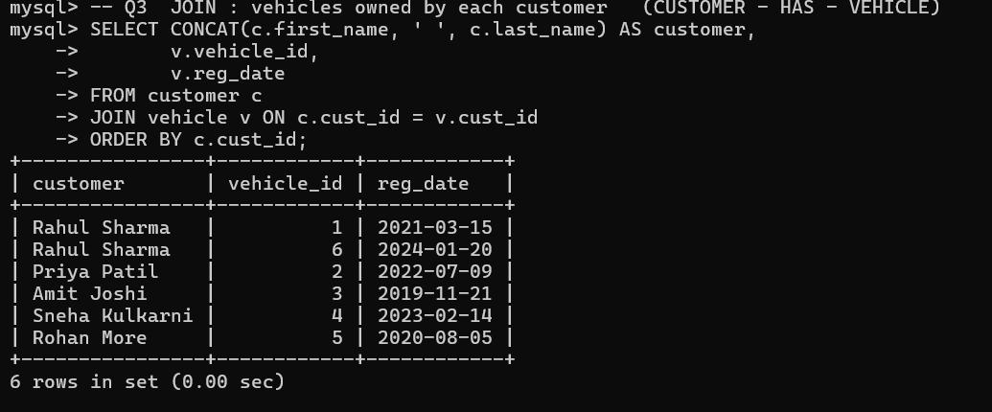
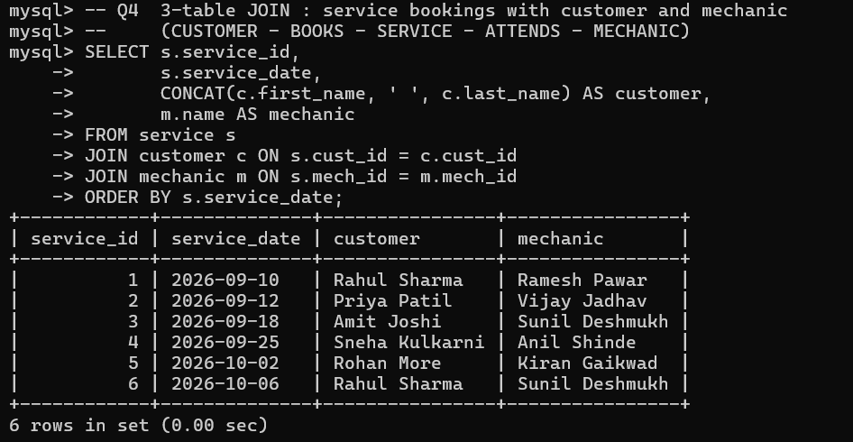
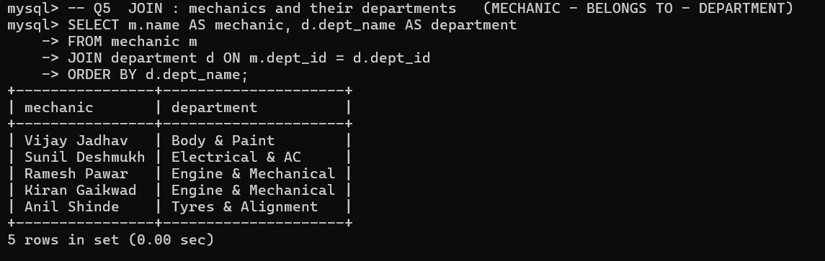
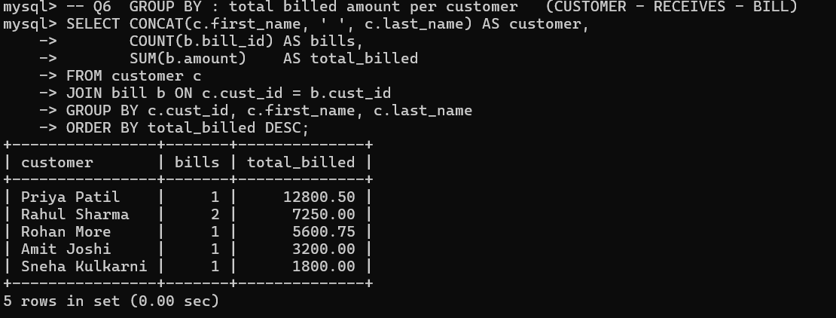

Slide 11
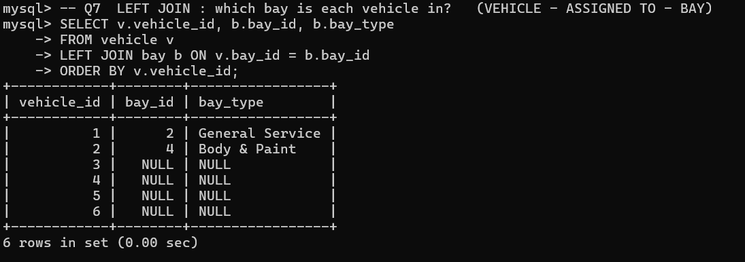
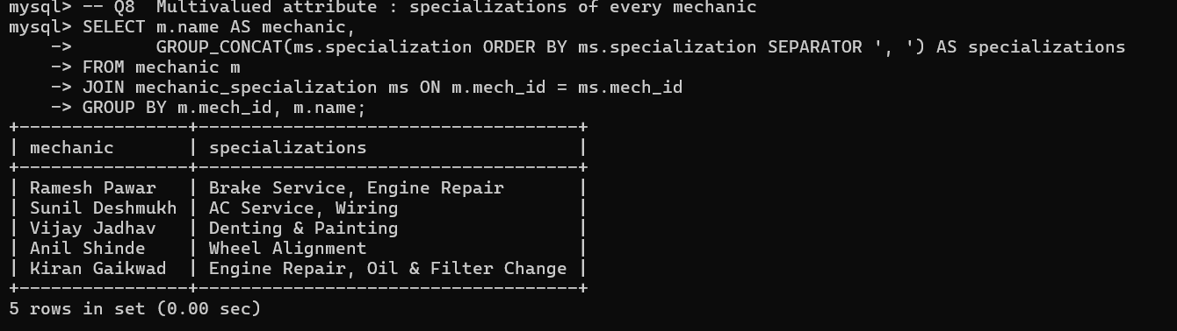
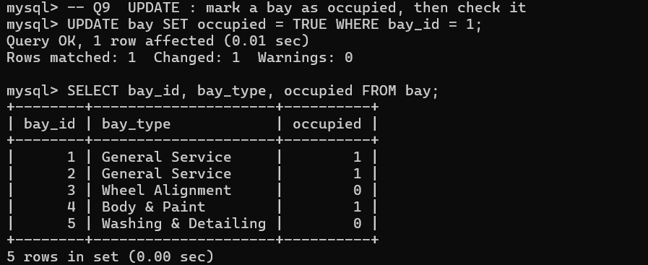

Slide 12

Conclusion
Conclusion
The Vehicle Service and Maintenance Management System shows how a relational database can replace manual service-centre records with organised, connected and quickly searchable data.
Key Outcomes
Future Scope
Organised storage of all service-centre data
Login and role-based access for customers, advisors and admins
Online service booking and reminders
Automatic bill calculation (parts + labour)
Bills linked to individual services and spare parts
Web or mobile front end
Less manual effort and fewer billing errors
Faster retrieval of service history using SQL
Related data connected through primary and foreign keys
Practical use of ER-to-relational mapping and SQL

Slide 13

References
Documentation & Tutorials
Books & Research Papers
MySQL 8.0 Reference Manual — dev.mysql.com/doc/refman/8.0/en
MySQL Workbench Manual — dev.mysql.com/doc/workbench/en
W3Schools: SQL Tutorial — w3schools.com/sql
GeeksforGeeks: DBMS and SQL — geeksforgeeks.org
DBMS course materials — JSPM’s Rajarshi Shahu College of Engineering
Database System Concepts — A. Silberschatz, H. F. Korth, S. Sudarshan, McGraw-Hill
Fundamentals of Database Systems — R. Elmasri, S. B. Navathe, Pearson
“A Relational Model of Data for Large Shared Data Banks” — E. F. Codd, Communications of the ACM, 1970
“The Entity-Relationship Model: Toward a Unified View of Data” — P. P. Chen, ACM Transactions on Database Systems, 1976

